Slide 1
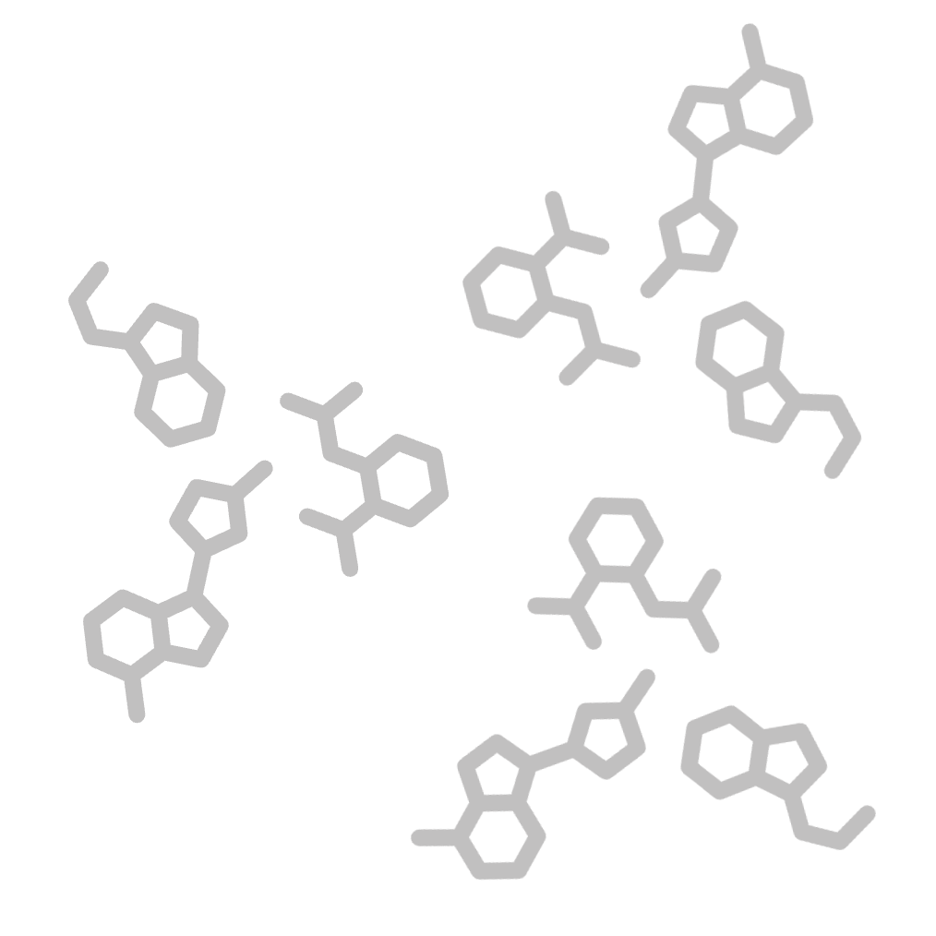
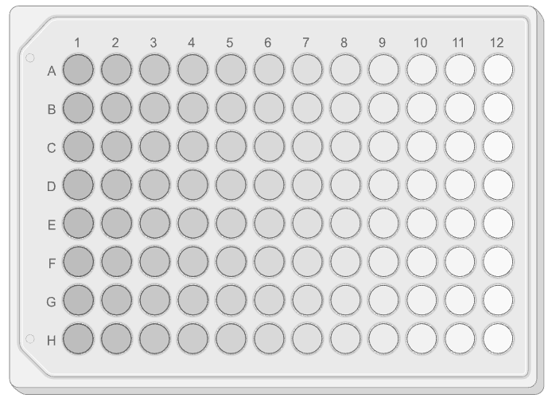
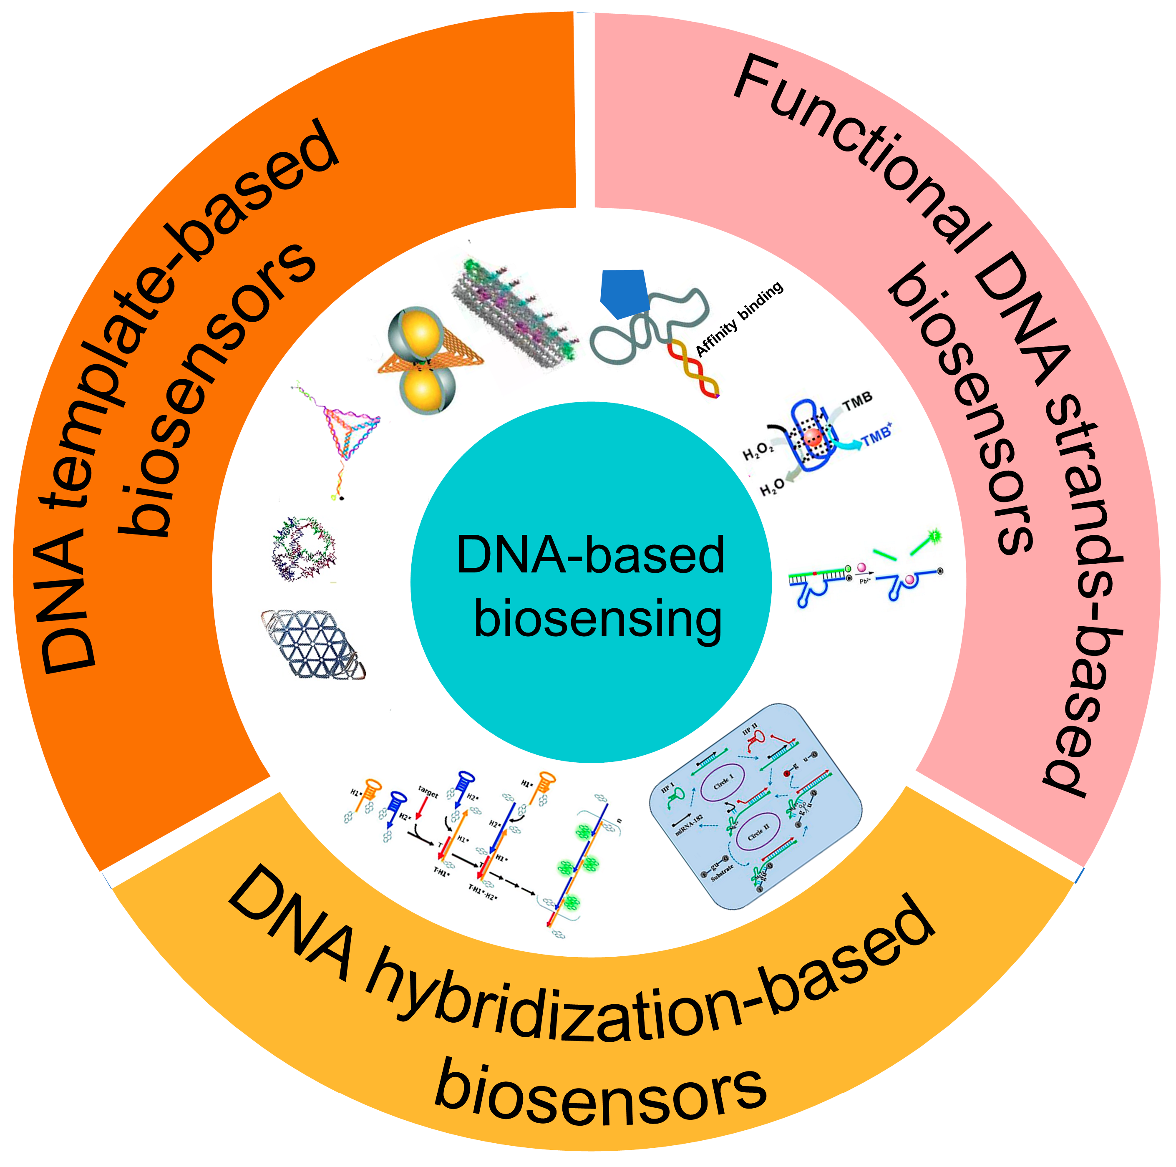

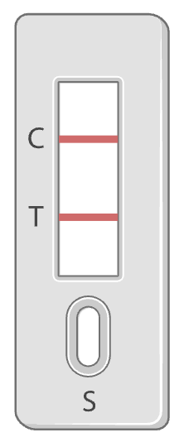
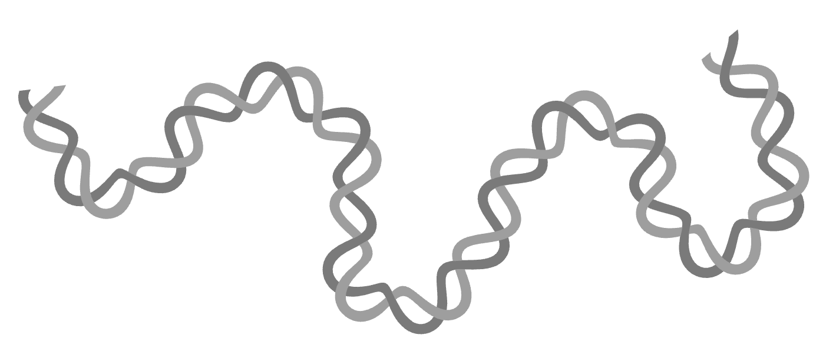
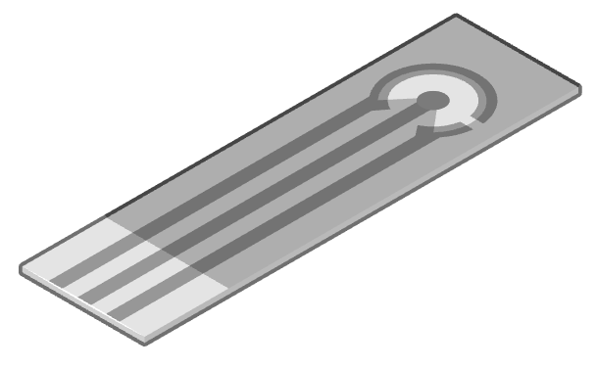

NA biosensing platform
Introduction
Nucleic Acid-based Biosensing Platform
Analyte
Recognition Unit
Amplification Unit
Transducer & Signals
DNA Nanotechnologies¹
Small Molecules
Fluorescence output (microplate)
Proteins
Colorimetric output (rapid test kit)
Nucleic Acids
Electrochemical output (electrode strip)
Cells
AgNC: Silver nanoclusters
Left & right illustrations adapted from Biorender.com
(1) Hua, Y., et al. (2022). Biosensors, 12(3), 183
(Thesis p.10) •

Slide 2
Schematic Workflow & Experimental Design
Experimental Setup
1
2
Data Collection
3
Data Preprocessing
4
Machine Learning
G4 Sequence Design
1
Sequence Embedding
1
Decision Tree
Random Forest
XGBoost
Gradient Boosting
CatBoost
LightGBM
Multilayer Perceptron
: ThT
DNA G4:
G | G | T | … | A | G | G
2
3
N₉G₃N₁₋₅G₃N₁₋₅G₃N₁₋₅G₃N₉
4
Feature
Extraction
5
Cation Conditions
Split G4 + Linker
6
K⁺, Na
Encoding + Padding
7
:
4 | 4 | 0 | … | 1 | 4 | 4
Intensity
!
Ensemble Voting
G4-specific Ligands
2
Signal Classification
Each G4-specific ligand is trained separately
Cl⁻
Thioflavin T (ThT)
Em. 440 nm Ex. 490 nm
Ligand: ThT
N
N
Intensity:
Strong
Mild
Weak
S
Signal Screening
5
User-friendly Platform
Probability of Predicted Signal Intensity (%)
For G4-specific ligands:
• G4 sequences (n = 85)
• Cation conditions (n = 2)
User’s Input
1
ssDNA G4
Cation Type
Ligand Type
2
3
Model Evaluation
(Thesis p.22-23) •

Slide 3
Experimental Design
Experimental Setup
2
3
4
DNA G-quadruplex Sequence Design
1
Loop Modification
L1 1st Loop
L3 3rd Loop
L1
L2
L3
1 1 1: F₉G₃N₁G₃N₁G₃N₁G₃F₉
Each number represents number
of nucleotide at each L1, L2, L3 loop
L2 2nd Loop
3’ Flanking
1
Different Loop Length
5’ Flanking
• Loop length: 111, 222 … 555
2
Different Length Combination
• Single loop: 211, 311 … 114, 115
• Double loop: 221, 331 … 144, 155
3
Point Mutation (T to A or C)
L1
L2
L3
L1A: F₉G₃AG₃TG₃TG₃F₉
L1
L2
L3
L2CT: F₉G₃TTG₃CTG₃TTG₃F₉
(Thesis p.34; 133-158) •

Slide 4
AI
Prediction for G4 Switch
ssDNA for G4
Random Forest
Decision Tree
Data Collection
High-throughput absorbance screening
XGBoost
Multilayer Perceptron
Split G4 + Linker
Split G4 + Linker + ThT
Machine Learning Algorithm

Slide 5
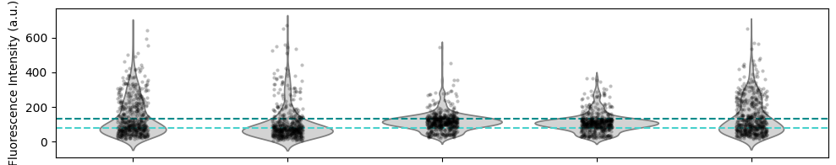
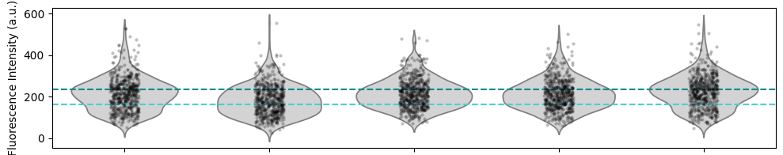
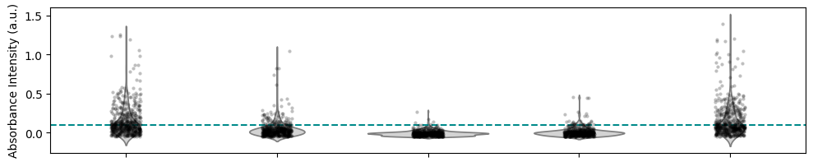
Data Preprocessing
1
2
Data Preprocessing
Classification of Signal Intensities
3
4
: Threshold line for mild intensity
: Threshold line for strong intensity
ThT
Intensity thresholds for ThT
< 80 a.u.
80 a.u. ≤ x ≤ 135 a.u.
> 135 a.u.
Weak (34.47%)
Mild (36.36%)
Strong (29.17%)
KCl
NaCl
CaCl₂
MgCl₂
Intercellular-based
o-BMVC
Intensity thresholds for o-BMVC
< 165 a.u.
165 a.u. ≤ x ≤ 235 a.u.
> 235 a.u.
Weak (29.77%)
Mild (35.58%)
Strong (38.3%)
KCl
NaCl
CaCl₂
MgCl₂
Intercellular-based
Hemin
Intensity thresholds for Hemin
< 0.1 a.u.
≥ 0.1 a.u.
Weak (53.8%)
Strong (46.2%)
(KCl only)
KCl
NaCl
CaCl₂
MgCl₂
Intercellular-based
Intercellular-based: 50 mM Tris-HCl (pH = 7.5), 140 mM KCl, 10 mM NaCl, 0.1 mM CaCl₂, 1 mM MgCl₂
(Thesis p.98-100) •

Slide 6
Data Preprocessing
1
2
Data Preprocessing
Feature Extraction of DNA G4 Sequence
3
4
…
2nd Loop
…
5’ Flanking
3’
Flanking
5’ Flanking
1st Loop
2nd Loop
3rd Loop
3’ Flanking
5’ CGAGTA GGG TTA GGG TTA GGG TTA GGG ACTGAT 3’
G1
G2
G3
G4
1st Loop
3rd Loop
Encoding A, T, C, G into 1, 2, 3, 4
Categorial features
for cation conditions
1: KCl
2: NaCl
3: CaCl₂
4: MgCl₂
5: Intercellular-based
5’ 3 4 1 4 2 1 4 4 4 2 2 1 4 4 4 2 2 1 4 4 4 2 2 1 4 4 4 1 3 2 4 1 2 3’
Dissecting G4 sequences to different sections
Top-up 0s based on maximum length for each G4 section
5’ Flanking
G1
1st Loop
3rd Loop
G4
3’ Flanking
3 | 4 | 1 | 4 | 2 | 1 | 0 | 0 | 0 | 4 | 4 | 4 | 0 | 2 | 2 | 1 | 0 | 0 | 0 | … | 2 | 2 | 1 | 0 | 0 | 0 | 4 | 4 | 4 | 0 | 1 | 3 | 2 | 4 | 1 | 2 | 0 | 0 | 0
1
2
…
4
5
3 | 4 | 1 | 4 | 2 | 1 | 0 | 0 | 0 | 4 | 4 | 4 | 0 | 2 | 2 | 1 | 0 | 0 | 0 | … | 2 | 2 | 1 | 0 | 0 | 0 | 4 | 4 | 4 | 0 | 1 | 3 | 2 | 4 | 1 | 2 | 0 | 0 | 0
0 | 0 | 0 | 0 | 0 | 0 | 0 | 0 | 0 | 4 | 4 | 4 | 4 | 3 | 2 | 1 | 0 | 0 | 0 | … | 3 | 2 | 1 | 0 | 0 | 0 | 4 | 4 | 4 | 4 | 0 | 0 | 0 | 0 | 0 | 0 | 0 | 0 | 0
 |  |  |  |  |  |  |  |  |  |  |  |  |  |  |  |  |  |  | …
3 | 4 | 3 | 3 | 4 | 1 | 4 | 4 | 1 | 4 | 4 | 4 | 0 | 1 | 1 | 0 | 0 | 0 | 0 | … | 1 | 1 | 0 | 0 | 0 | 0 | 4 | 4 | 4 | 0 | 1 | 3 | 2 | 4 | 3 | 4 | 4 | 4 | 4
2 | 2 | 2 | 2 | 2 | 2 | 0 | 0 | 0 | 4 | 4 | 4 | 0 | 2 | 2 | 2 | 2 | 2 | 0 | … | 2 | 2 | 2 | 2 | 2 | 0 | 4 | 4 | 4 | 0 | 2 | 2 | 2 | 2 | 2 | 2 | 0 | 0 | 0
4
Machine
Learning Models
x 2640
x 56 (1 feature for cation conditions and 55 features for DNA nucleotide positions)
(Thesis p.101) •

